Slide 1
Chapter 15
Basics of Functional Dependencies and Normalization for Relational Databases

Slide 2
Chapter 15 Outline
Informal Design Guidelines for Relation Schemas
Functional Dependencies
Normal Forms Based on Primary Keys
General Definitions of Second and Third Normal Forms
Boyce-Codd Normal Form

Slide 3
Chapter 15 Outline (cont’d.)
Multivalued Dependency and Fourth Normal Form
Join Dependencies and Fifth Normal Form

Slide 4
Introduction
Levels at which we can discuss goodness of relation schemas
  Logical (or conceptual) level
  Implementation (or physical storage) level
Approaches to database design:
  Bottom-up or top-down

Slide 5
Informal Design Guidelines for Relation Schemas
Measures of quality
  Making sure attribute semantics are clear
  Reducing redundant information in tuples
  Reducing NULL values in tuples
  Disallowing possibility of generating spurious tuples

Slide 6
Imparting Clear Semantics to Attributes in Relations
Semantics of a relation
  Meaning resulting from interpretation of attribute values in a tuple
Easier to explain semantics of relation
  Indicates better schema design

Slide 7
Guideline 1
Design relation schema so that it is easy to explain its meaning
Do not combine attributes from multiple entity types and relationship types into a single relation
Example of violating Guideline 1: Figure 15.3

Slide 8
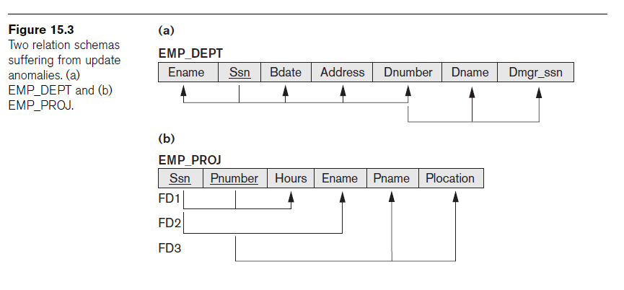
Guideline 1 (cont’d.)

Slide 9
Redundant Information in Tuples and Update Anomalies
Grouping attributes into relation schemas
  Significant effect on storage space
Storing natural joins of base relations leads to update anomalies
Types of update anomalies:
  Insertion – consistency and NULL values
  Deletion – loss of information
  Modification

Slide 10
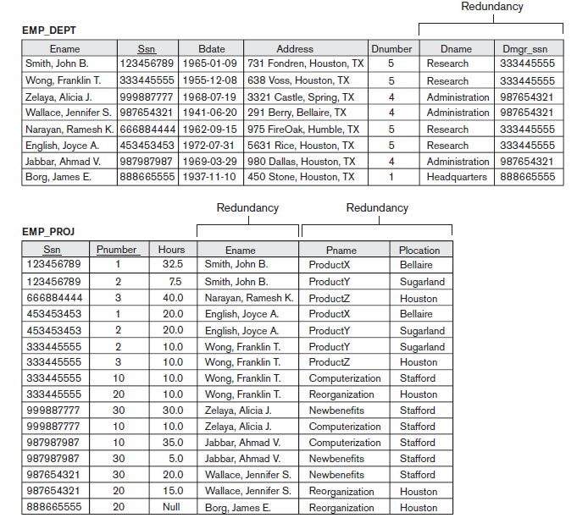

Slide 11
Guideline 2
Design base relation schemas so that no update anomalies are present in the relations
If any anomalies are present:
  Note them clearly
  Make sure that the programs that update the database will operate correctly

Slide 12
NULL Values in Tuples
May group many attributes together into a “fat” relation
  Can end up with many NULLs
Problems with NULLs
  Wasted storage space
  Problems understanding meaning

Slide 13
Guideline 3
Avoid placing attributes in a base relation whose values may frequently be NULL
If NULLs are unavoidable:
  Make sure that they apply in exceptional cases only, not to a majority of tuples

Slide 14
Generation of Spurious Tuples
Figure 15.5(a)
  Relation schemas EMP_LOCS and EMP_PROJ1
NATURAL JOIN
  Result produces many more tuples than the original set of tuples in EMP_PROJ
  Called spurious tuples
  Represent spurious information that is not valid

Slide 15
Guideline 4
Design relation schemas to be joined with equality conditions on attributes that are appropriately related
  Guarantees that no spurious tuples are generated
Avoid relations that contain matching attributes that are not (foreign key, primary key) combinations

Slide 16
Summary and Discussion of Design Guidelines
Anomalies cause redundant work to be done
Waste of storage space due to NULLs
Difficulty of performing operations and joins due to NULL values
Generation of invalid and spurious data during joins

Slide 17
Functional Dependencies
Formal tool for analysis of relational schemas
Enables us to detect and describe some of the above-mentioned problems in precise terms
Theory of functional dependency

Slide 18
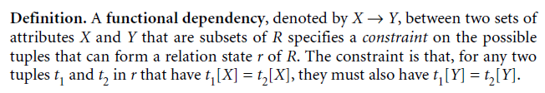
Definition of Functional Dependency
Constraint between two sets of attributes from the database
Property of semantics or meaning of the attributes
Legal relation states
  Satisfy the functional dependency constraints

Slide 19
Definition of Functional Dependency (cont’d.)
Given a populated relation
  Cannot determine which FDs hold and which do not
  Unless meaning of and relationships among attributes known
  Can state that FD does not hold if there are tuples that show violation of such an FD

Slide 20
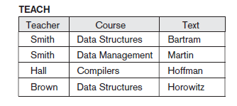

Slide 21

Inference Rules

Slide 22
Normal Forms Based on Primary Keys
Normalization process
Approaches for relational schema design
  Perform a conceptual schema design using a conceptual model then map conceptual design into a set of relations
  Design relations based on external knowledge derived from existing implementation of files or forms or reports

Slide 23

Normalization of Relations
Takes a relation schema through a series of tests
  Certify whether it satisfies a certain normal form
  Proceeds in a top-down fashion
Normal form tests

Slide 24
Normalization of Relations (cont’d.)
Properties that the relational schemas should have:
  Nonadditive join property - No spurious tuples
    Extremely critical
  Dependency preservation property
    Desirable but sometimes sacrificed for other factors

Slide 25
Practical Use of Normal Forms
Normalization carried out in practice
  Resulting designs are of high quality and meet the desirable properties stated previously
  Pays particular attention to normalization only up to 3NF, BCNF, or at most 4NF
Do not need to normalize to the highest possible normal form

Slide 26

Definitions of Keys and Attributes Participating in Keys
Definition of superkey and key
Candidate key
  If more than one key in a relation schema
    One is primary key
    Others are secondary keys

Slide 27
First Normal Form
Part of the formal definition of a relation in the basic (flat) relational model
Only attribute values permitted are single atomic (or indivisible) values
Techniques to achieve first normal form
  Remove attribute and place in separate relation
  Expand the key
  Use several atomic attributes

Slide 28
First Normal Form (cont’d.)
Does not allow nested relations
  Each tuple can have a relation within it
To change to 1NF:
  Remove nested relation attributes into a new relation
  Propagate the primary key into it
  Unnest relation into a set of 1NF relations

Slide 29
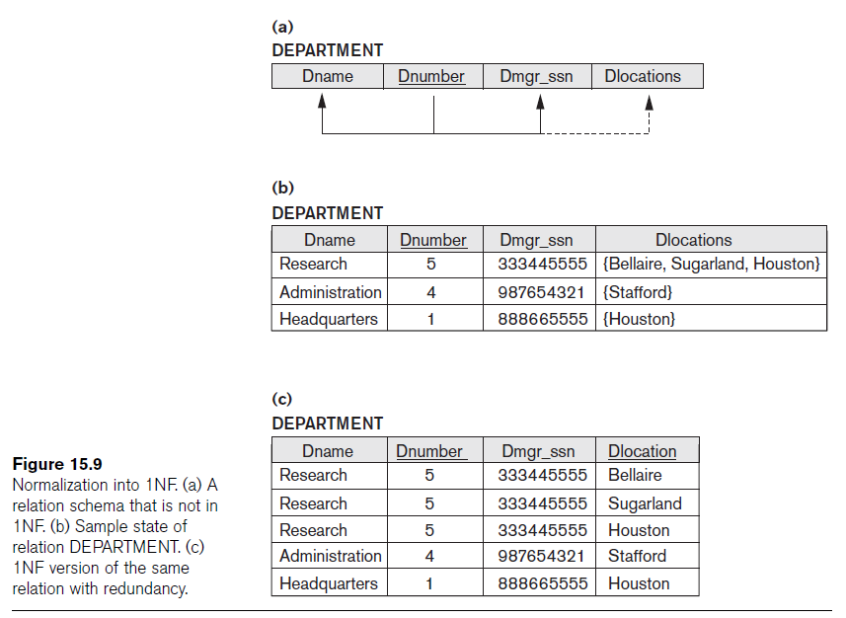

Slide 30
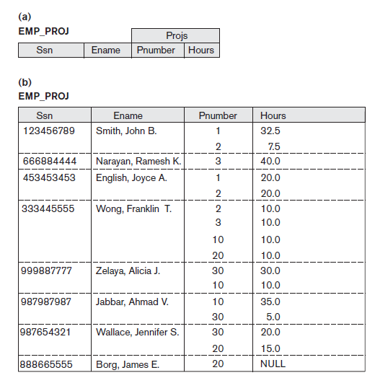

Slide 31
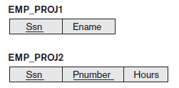

Slide 32


Slide 33
Second Normal Form
Based on concept of full functional dependency
  Versus partial dependency
Second normalize into a number of 2NF relations
  Nonprime attributes are associated only with part of primary key on which they are fully functionally dependent

Slide 34
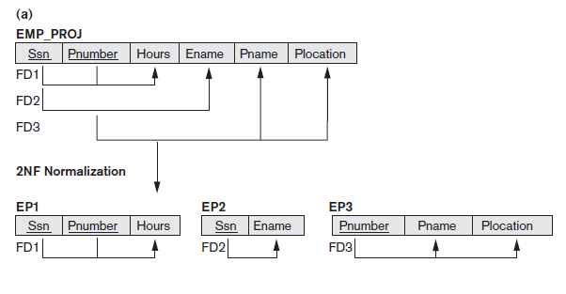

Slide 35

Third Normal Form
Based on concept of transitive dependency
Problematic FD
  Left-hand side is part of primary key
  Left-hand side is a nonkey attribute

Slide 36
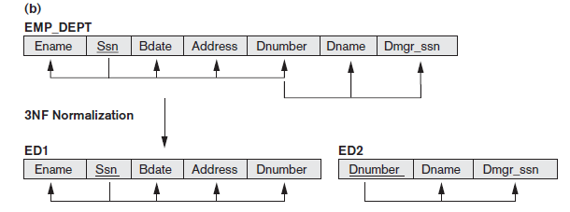

Slide 37
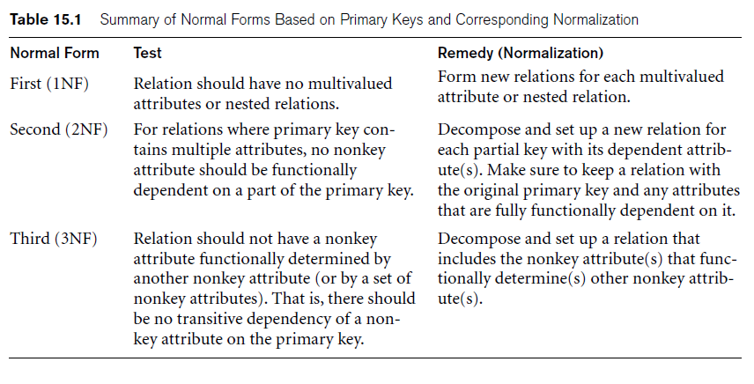
General Definitions of Second and Third Normal Forms

Slide 38
General Definitions of Second and Third Normal Forms (cont’d.)
Prime attribute
  Part of any candidate key will be considered as prime
Consider partial, full functional, and transitive dependencies with respect to all candidate keys of a relation

Slide 39
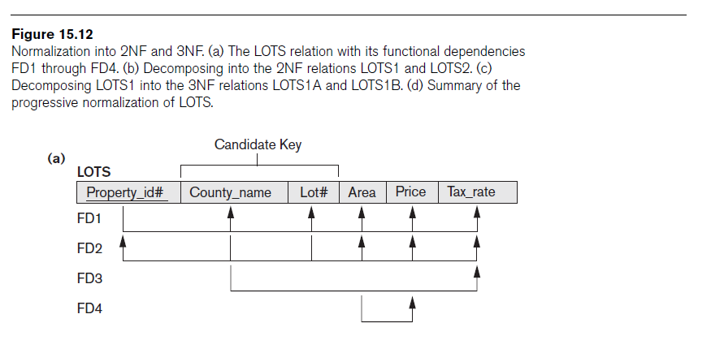
General Definition of Second Normal Form

Slide 40
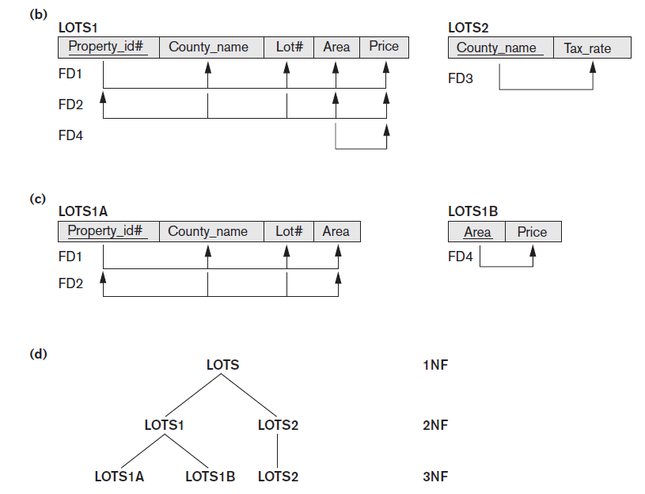

Slide 41

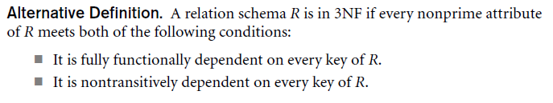
General Definition of Third Normal Form

Slide 42

Boyce-Codd Normal Form
Every relation in BCNF is also in 3NF
  Relation in 3NF is not necessarily in BCNF
Difference:
  Condition which allows A to be prime is absent from BCNF
Most relation schemas that are in 3NF are also in BCNF

Slide 43
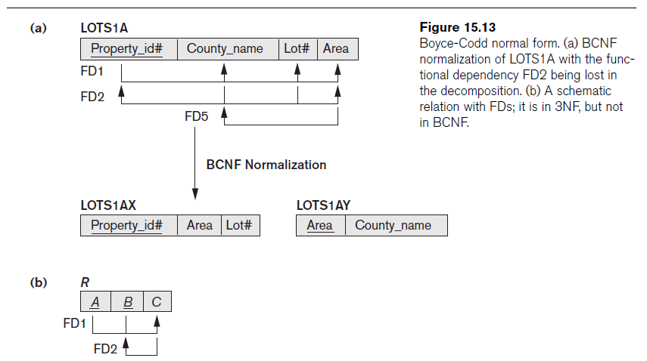

Slide 44



Slide 45


Slide 46
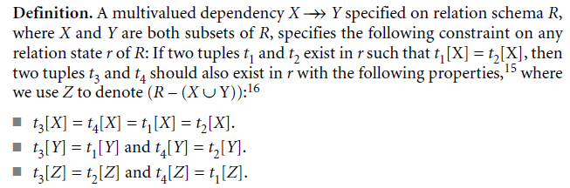
Multivalued Dependency and Fourth Normal Form
Multivalued dependency (MVD)
  Consequence of first normal form (1NF)

Slide 47
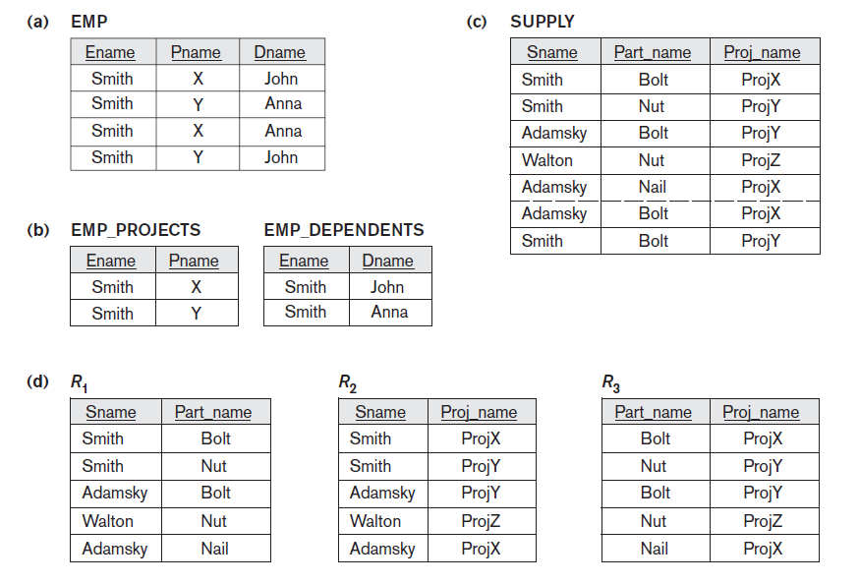

Slide 48

Multivalued Dependency and Fourth Normal Form (cont’d.)
Relations containing nontrivial MVDs
  All-key relations
Fourth normal form (4NF)
  Violated when a relation has undesirable multivalued dependencies

Slide 49
Join Dependencies and Fifth Normal Form
Join dependency
Multiway decomposition into fifth normal form (5NF)
Very peculiar semantic constraint
  Normalization into 5NF is very rarely done in practice

Slide 50
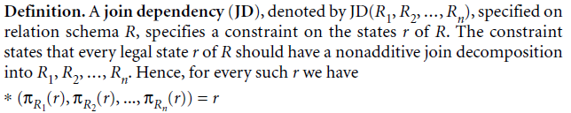
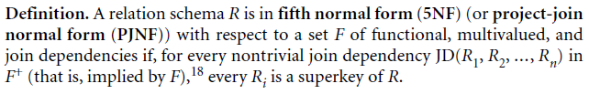
Join Dependencies and Fifth Normal Form (cont’d.)

Slide 51
Summary
Informal guidelines for good design
Functional dependency
  Basic tool for analyzing relational schemas
Normalization:
  1NF, 2NF, 3NF, BCNF, 4NF, 5NF

